Slide 1

Mária Magdolna:
Gyere Jézushoz, hogy megtérj!
Lukács 23,4. 21-23. 32-49; János 20,1-18

Slide 3
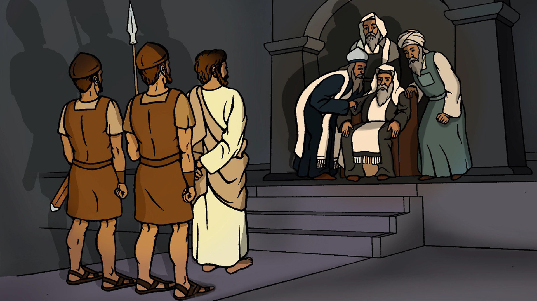
Notes:
They took Jesus to the house of the High Priest. All of the Jewish council gathered there and were trying to find someone who would say what crime Jesus had committed so that they could have Him killed. But they could not find anything that they could accuse Him.
Then the High Priest asked Jesus, ‘Are you the Messiah, the Son of the Blessed God?’
And Jesus said, ‘I am. And you will see the Son of Man sitting at the right hand of God Almighty.’

Slide 4
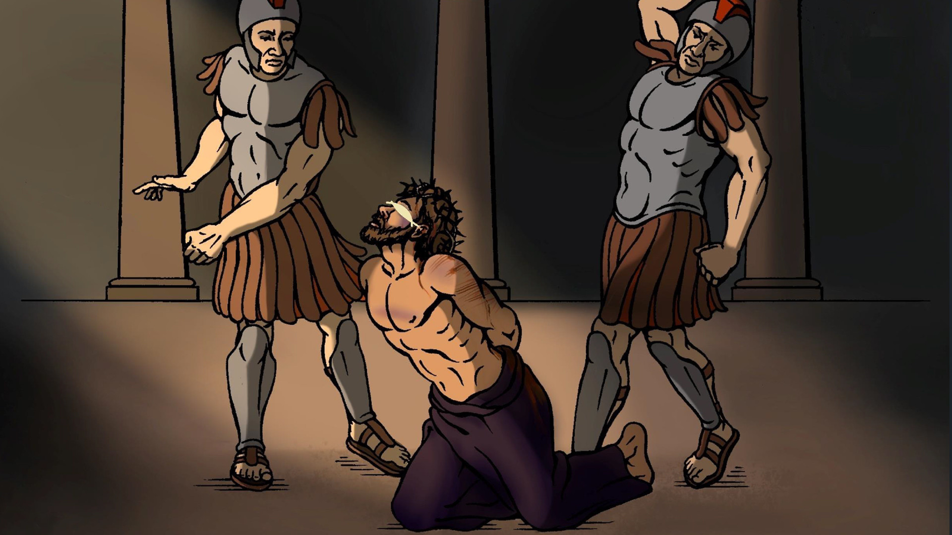
Notes:
Some of the people started to spit on Jesus. They blindfolded Him and beat Him, saying, ‘If you are really a prophet, tell us, who hit you?’ Then the guards took Jesus and were slapping Him.

Slide 5
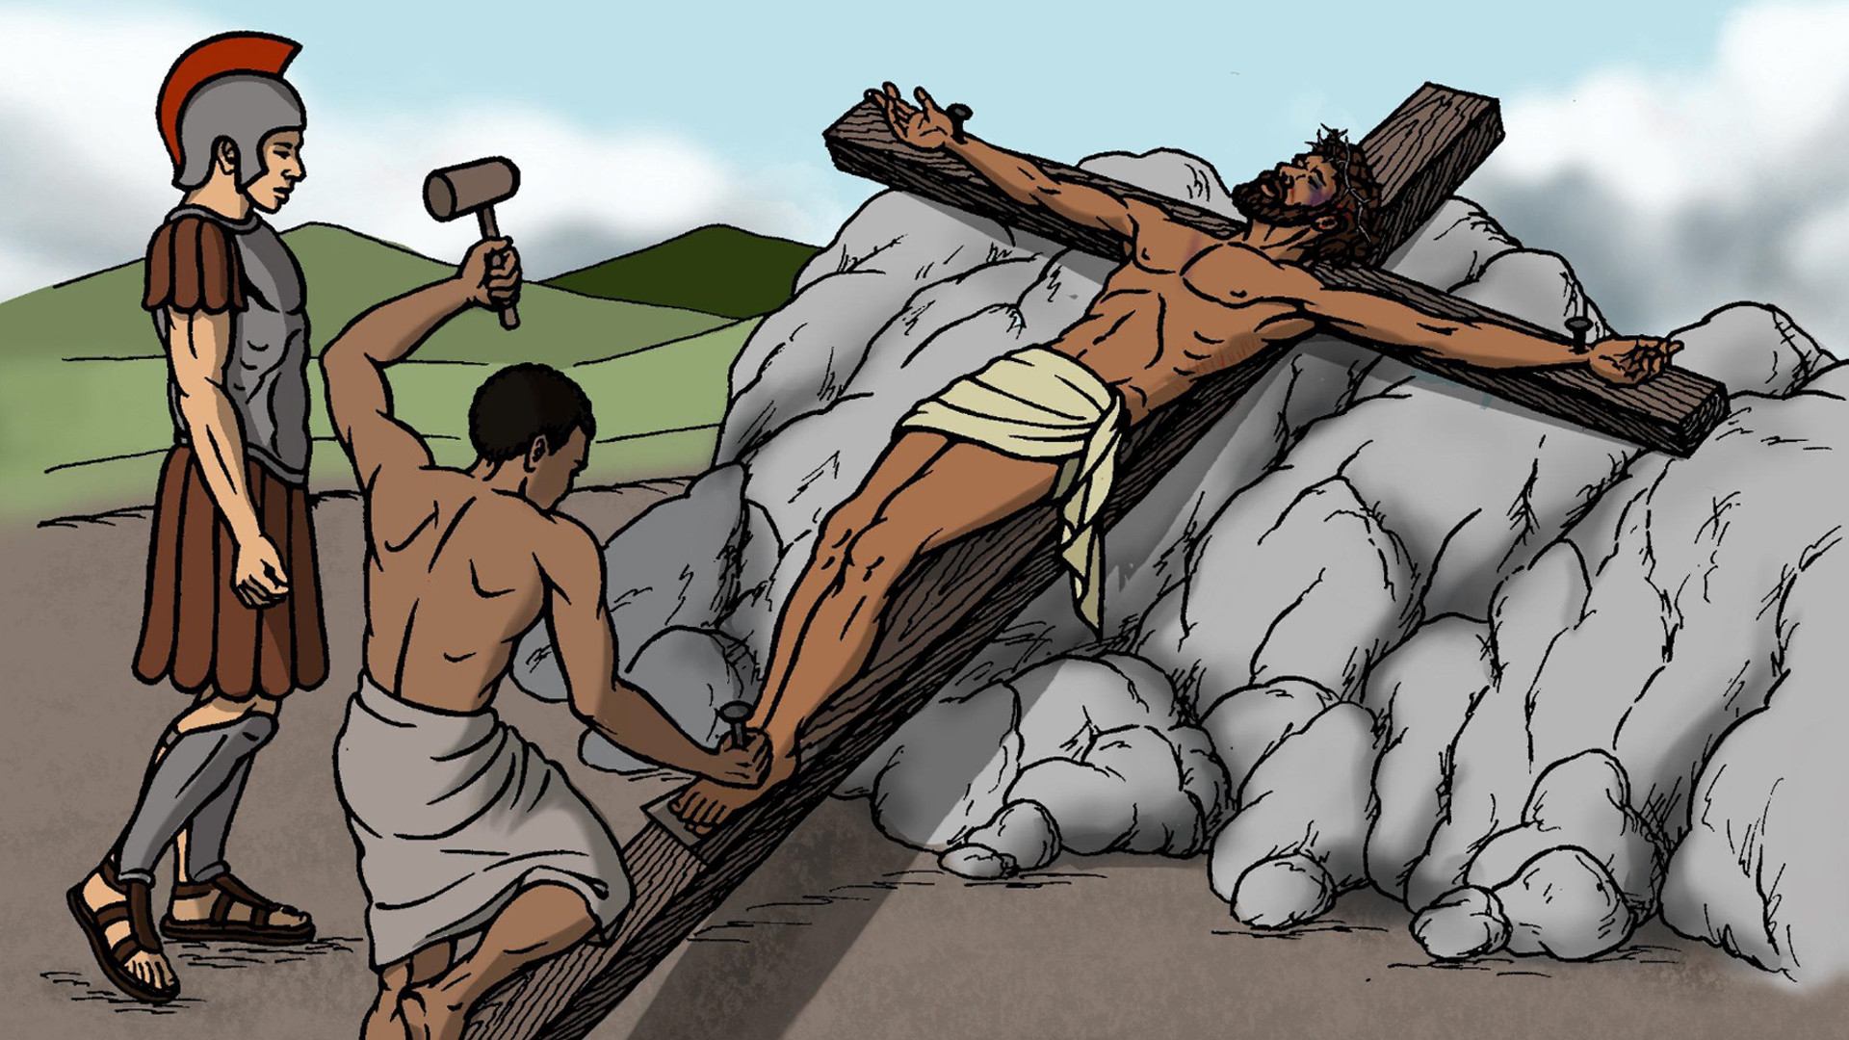
Notes:
When they finished ridiculing Jesus, they took Him to a place called Golgotha. They nailed Him to a cross and attached a sign with the reason that He was being crucified. It said, ‘The king of the Jews.’

Slide 6
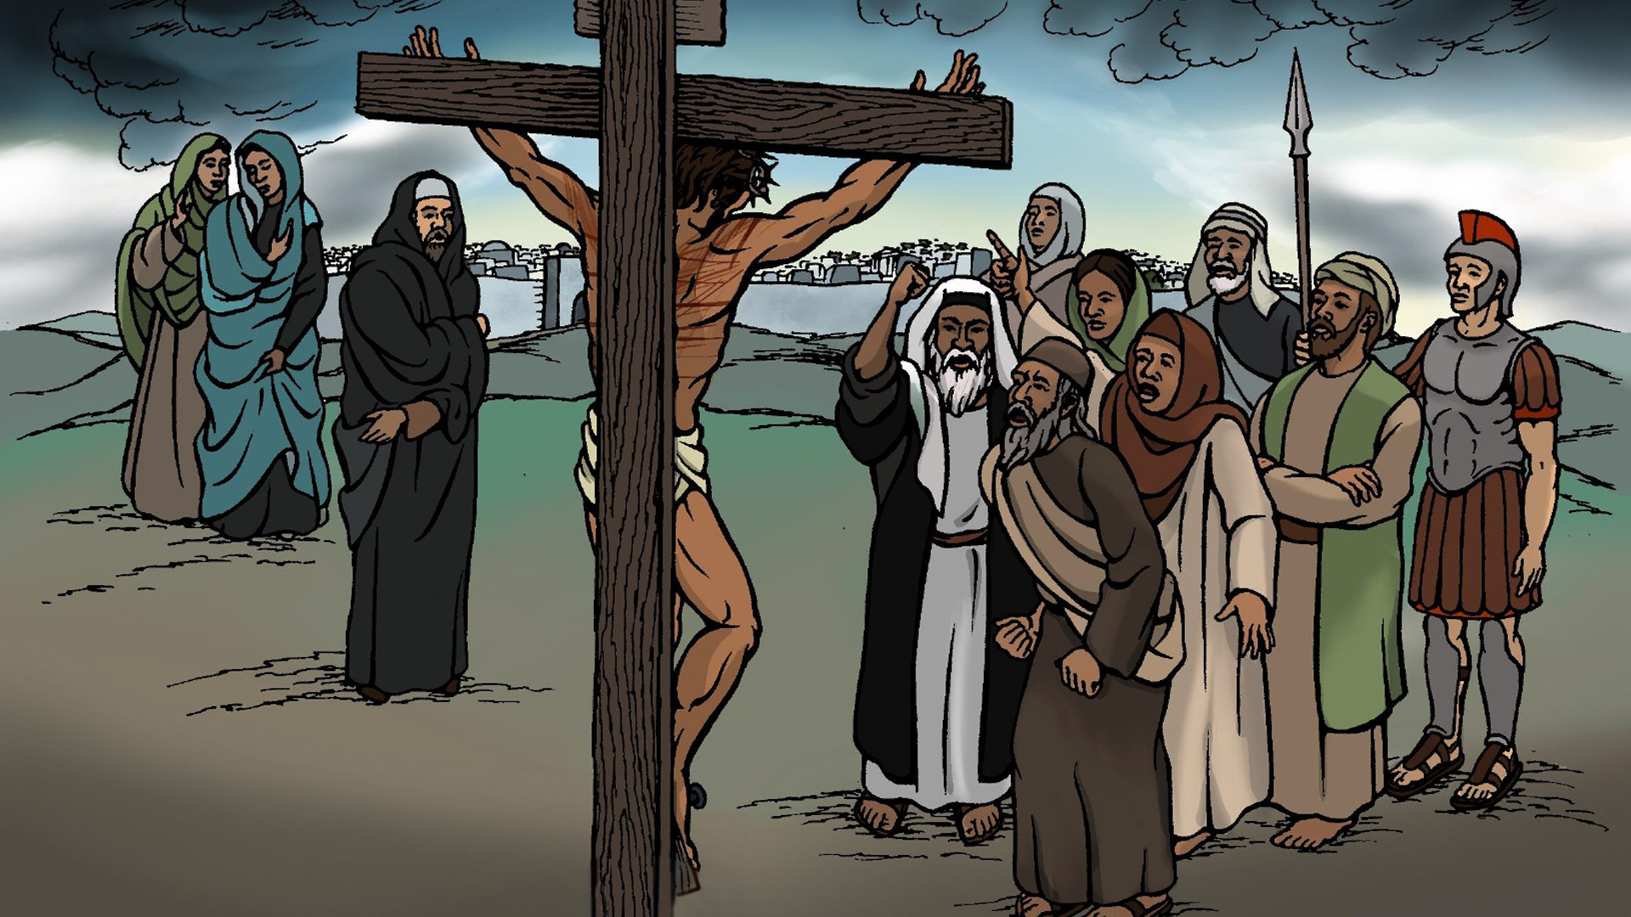
Notes:
The chief priests and the teachers of the law made fun of Jesus, saying, ‘He only healed other people, but He can’t save himself. He should come down from the cross right now. Then we will see and believe.’
At three o’clock, Jesus cried out, ‘Eloi, eloi, lema sabachthani?’ which means, ‘My God, my God, why have you abandoned me?’
Then Jesus gave a loud shout and took His last breath and died.

Slide 7
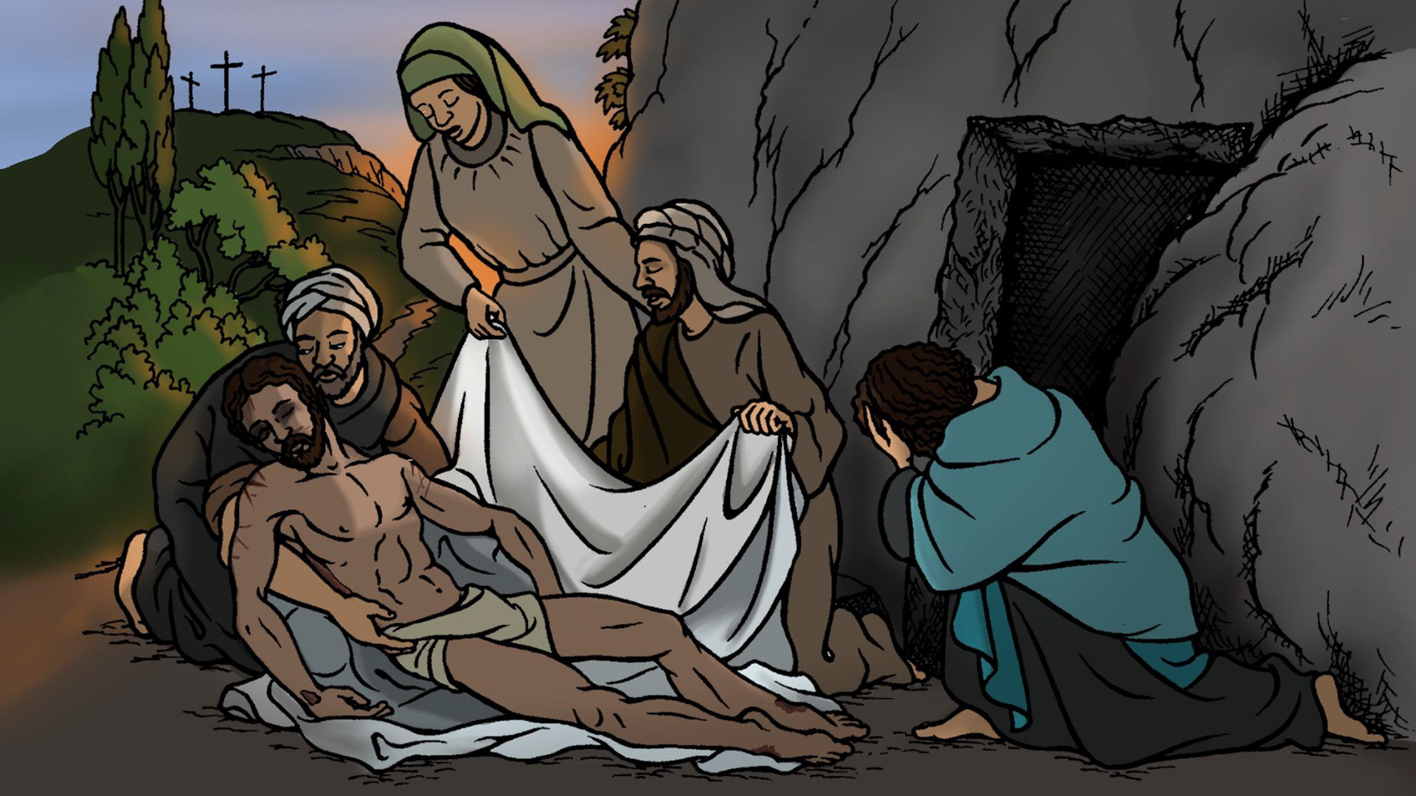
Notes:
Joseph, a man from Arimathea, took Jesus’ body down from the cross. He wrapped the body in a linen cloth and put Jesus in a tomb that had been dug out of rock. Then he rolled a large stone in front of the entrance.

Slide 8
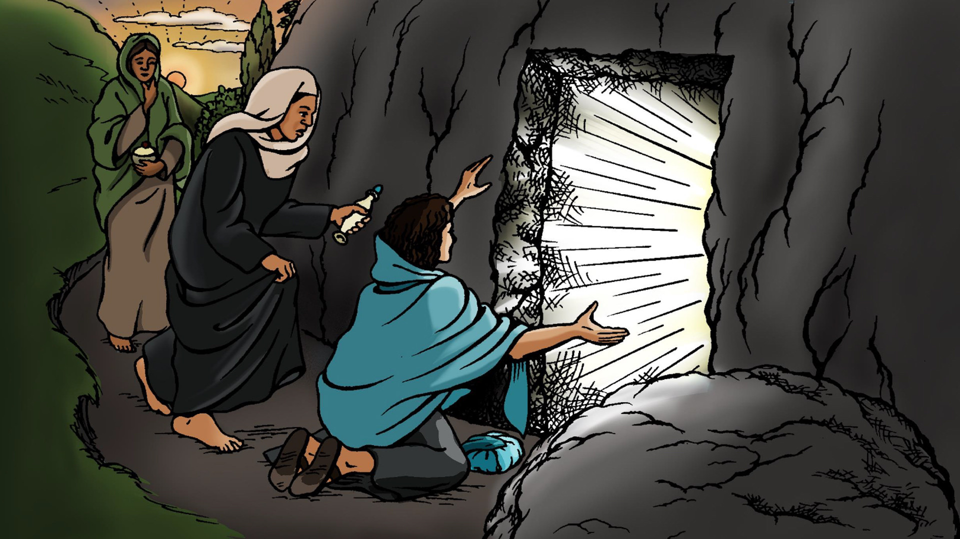
Notes:
On Sunday morning, Mary Magdalene, Salome, and Mary the mother of James, went to the tomb and saw that the large stone had been rolled away from the entrance.

Slide 9
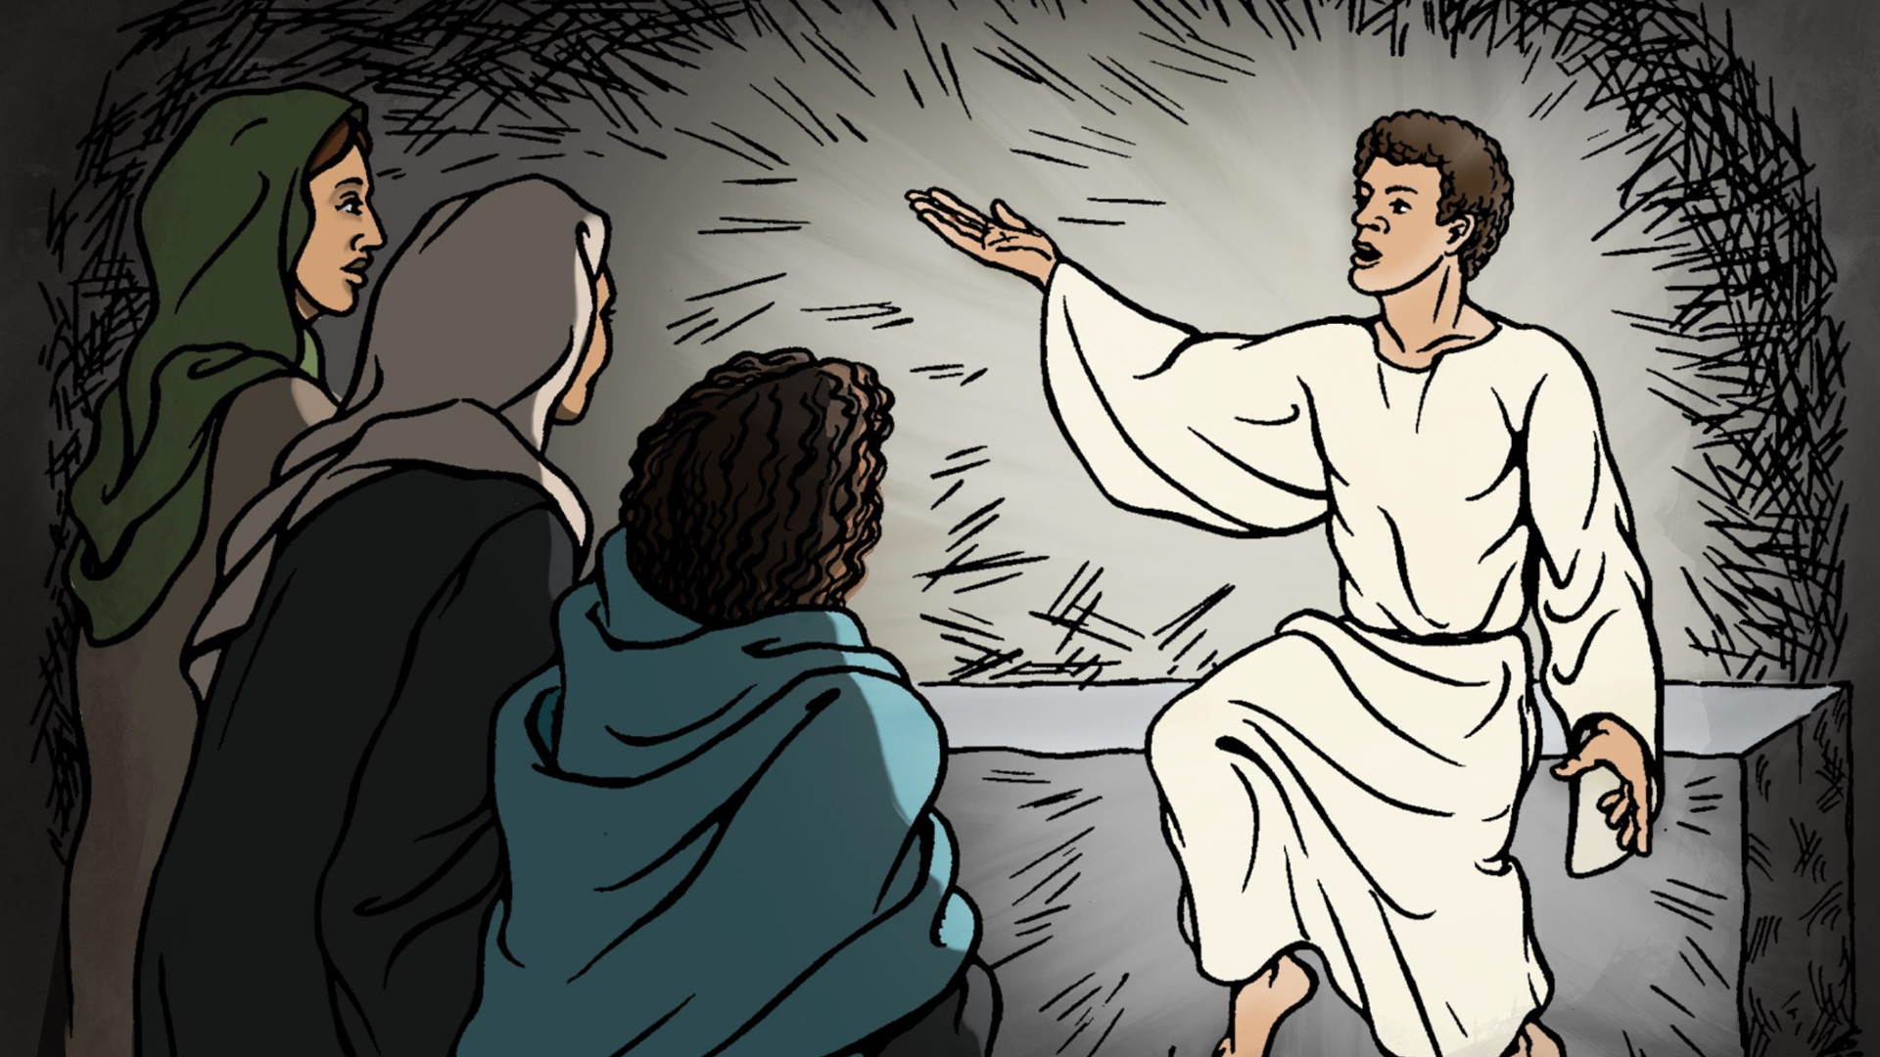
Notes:
When they went into the tomb, they saw a young man wearing white clothes, and they were shocked. But the young man said to them, ‘Don’t be afraid. I know you are looking for Jesus of Nazareth who was crucified.’
‘He has risen from the dead. He’s not here! Go to Peter and the other disciples and say, “Jesus is going ahead of you to Galilee and you will see Him there, just as He told you.”’

Slide 10
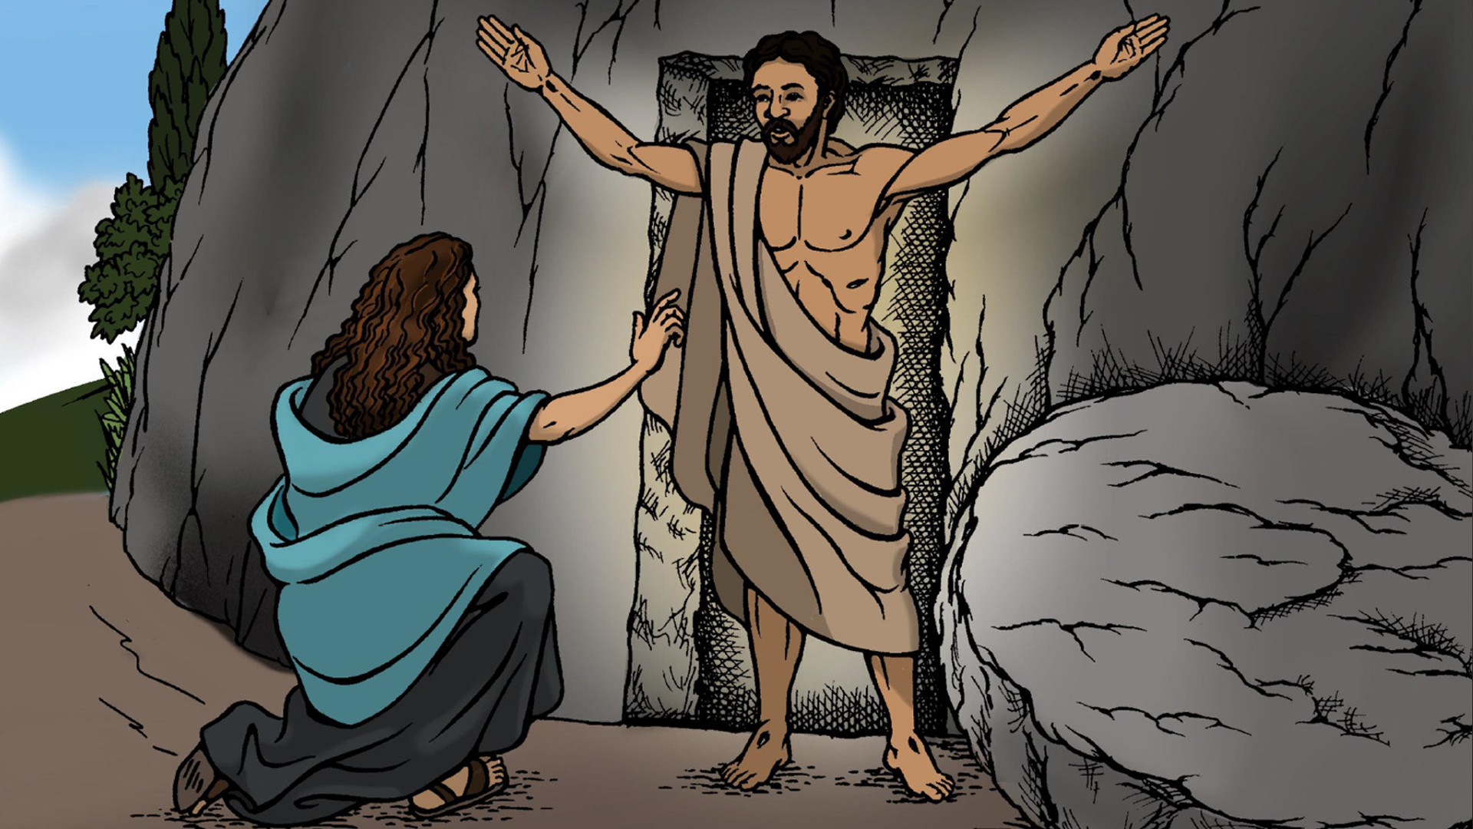
Notes:
After Jesus rose from the dead on Sunday, He appeared first to Mary Magdalene. He had cast seven demons out of her in the past. Mary then told the others that Jesus was alive again, but they didn’t believe her.

